Slide 1
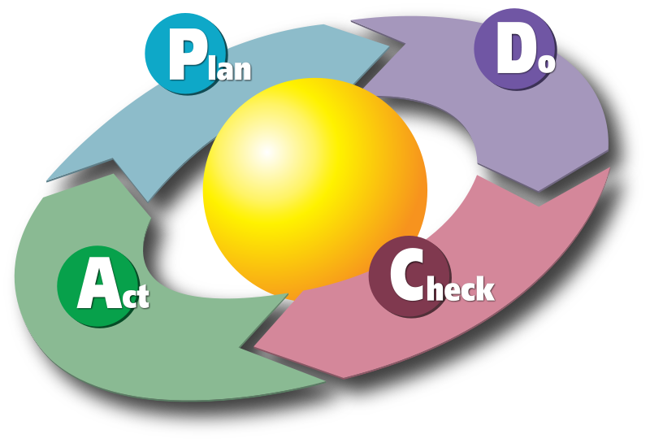
Test Driven Development
C# , Xunit, Jasmine and JMeter

Slide 2
TDD Goals
• What is testing
• Testing types
• Life Cycles(SDLC,STLC,BLC)
• Test Plan
• Test Strategy
• Test Scenario
• Test case Preparation(Component and Functional)
• Test data Preparation
• Defect Report
• Defect Classification

Slide 3
TDD Goals
What Is Test-driven Development
How Do I Adopt TDD?
Testing Concepts
Test-driven Development Concepts
Testing Tools
Setting Up Testing Infrastructure
Automation testing introduction
Automation Tools in Market(Win runner, Silk Test, QTP, UFT ,VSTS) with brief introduction

Slide 4
Testing Concepts
Software testing is a process of executing a program or application with the intent of finding the errors.
The process of verifying and validating that a software program or application or product:
Meets the business and technical requirements.
Works as expected.
Can be implemented with the same characteristic.

Slide 5
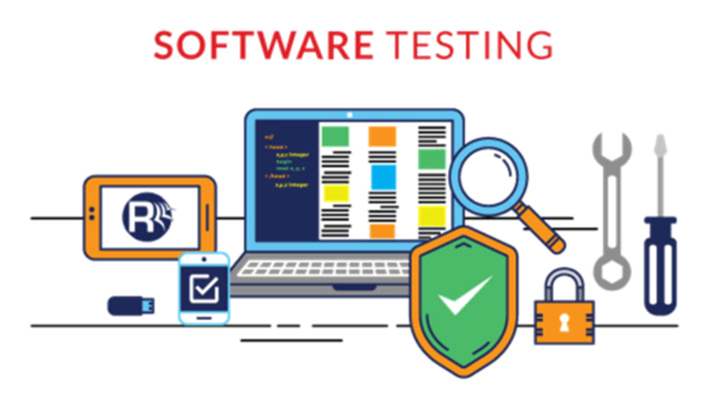
Testing Concepts

Slide 6
Testing Concepts
SOFTWARE TESTING is defined as an activity to check whether the actual results match the expected results and to ensure that the software system is Defect free.
It involves execution of a software component or system component to evaluate one or more properties of interest.
Software testing also helps to identify errors, gaps or missing requirements in contrary to the actual requirements.
It can be either done manually or using automated tools.
Some prefer saying Software testing as a White Box and Black Box Testing.

Slide 7
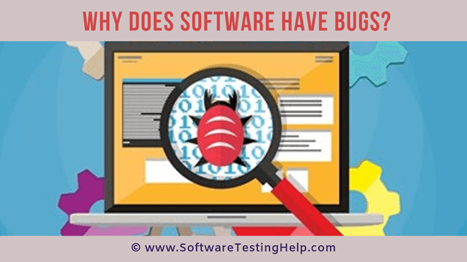
Why Does Software Have Bugs?

Slide 8
Why Does Software Have Bugs?
A Software Bug is a failure or flaw in a program that produces undesired or incorrect results.
It’s an error that prevents the application from functioning as it should.

Slide 9

Why Does Software Have Bugs?
There are many reasons for Software Bugs. The most common reason is human mistakes in software design and coding.
Once we know the causes for Software Defects it will be easier for us to take corrective actions to minimize these defects.

Slide 10
Why Does Software Have Bugs?
Top 20 Reasons For Software Bugs
#1) Miscommunication or No Communication
#2) Software Complexity
#3) Programming Errors
#4) Changing Requirements
#5) Time Pressures
#6) Egotistical or Overconfident People
#7) Poorly Documented Code

Slide 11
Why Does Software Have Bugs?
#8) Software Development Tools
#9) Obsolete Automation Scripts
#10) Lack of Skilled Testers
#11) Not having a proper test setup (test environment) for testing all requirements.
#12) Starting to write code or test cases without understanding the requirements clearly.
#13) The incorrect design which leads to issues being carried out in all phases of the Software Development Cycle.

Slide 12
Why Does Software Have Bugs?
#14) Releasing software patches frequently without completing the Software Testing Life Cycle.
#15) Not providing training to resources for the skills needed for developing or testing the application properly.
#16) Giving very little or no time for Regression Testing.
#17) Not Automating Repetitive Test Cases and depending on the testers for manual verification every time.
#18) Not prioritizing test execution.

Slide 13
Why Does Software Have Bugs?
#19) Not tracking the development and test execution progress continuously. Last-minute changes are likely to introduce errors.
#20) The wrong assumption made while coding and testing stages.

Slide 14
Goals Test Automation
Tests should help us improve quality.
Tests should help us understand the SUT.
Tests should reduce (and not introduce) risk.
• Tests should be easy to run.
Tests should be easy to write and maintain.
Tests should require minimal maintenance as the system evolves around them.

Slide 15
Why is Testing important?
Software Testing is important because of the following reasons:
Software Testing points out the defects and errors that were made during the development phases.
It looks for any mistake made by the programmer during the implementation phase of the software.
It ensures that the customer finds the organization reliable and their satisfaction in the application is maintained.
Sometimes contracts include monetary penalties with respect to the timeline and quality of the product and software testing prevent monetary losses.

Slide 16
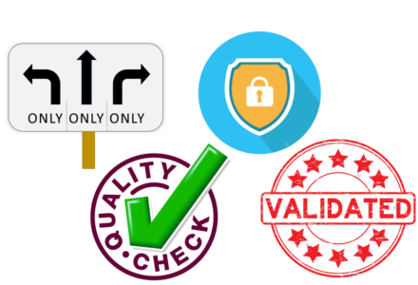
Why is Testing important?

Slide 17
Why is Testing important?
It also ensures the Quality of the product.
Quality product delivered to the customers helps in gaining their confidence.
It makes sure that the software application requires lower maintenance cost and results in more accurate, consistent and reliable results.
Users are not inclined to use software that has bugs.
They may not adopt software if they are not happy with the stability of the application.
Testing is important for the product to stay in business.
It’s important to ensure that the application should not result in any failures because it can be very expensive in the future or in the later stages of the development.

Slide 18
Software Testing Life Cycle
Software Testing Life Cycle (STLC) defines a series of activities conducted to perform Software Testing.
It identifies what test activities to carry out and when to accomplish those test activities.
In the STLC process, each activity is carried out in a planned and systematic way and each phase has different goals and deliverable.

Slide 19
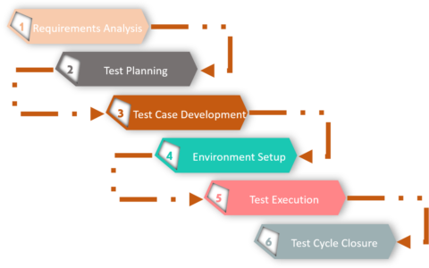
Software Testing Life Cycle

Slide 20
Software Testing Life Cycle
The different phases of Software testing life cycle are:
Requirement Analysis
Test Planning
Test Case Development
Environment Setup
Test Execution
Test Cycle Closure

Slide 21
Software Testing Life Cycle
Each of these stages has a definite Entry and Exit criteria, Activities & Deliverables associated with it.
What is Entry and Exit Criteria?
Entry Criteria: Entry Criteria gives the prerequisite items that must be completed before testing can begin.
Exit Criteria: Exit Criteria defines the items that must be completed before testing can be concluded.
We have Entry and Exit Criteria for all levels in the Software Testing Life Cycle (STLC).
In an Ideal world, we will not enter the next stage until the exit criteria for the previous stage is met.

Slide 22
Software Testing Life Cycle
Requirement Analysis
Requirement Analysis is the first step involved in Software testing life cycle.
In this step, Quality Assurance (QA) team understands the requirement in terms of what we will testing & figure out the testable requirements.
During this phase, test team studies the requirements from a testing point of view to identify the testable requirements.
The QA team may interact with various stakeholders such as client, business analyst, technical leads, system architects etc. to understand the requirements in detail.

Slide 23
Software Testing Life Cycle
Activities
Identify types of tests to be performed.
Gather details about testing priorities and focus.
Prepare Requirement Traceability Matrix (RTM).
Identify test environment details where testing is supposed to be carried out.
Automation feasibility analysis (if required).
Deliverables
RTM
Automation feasibility report. (if applicable)

Slide 24
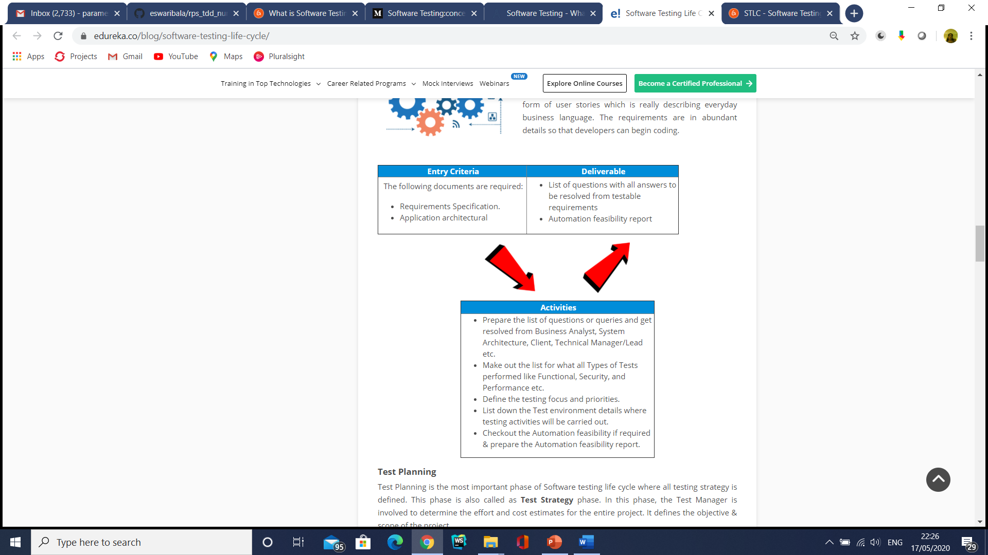
Software Testing Life Cycle

Slide 25

Software Testing Life Cycle
The different types of Requirements include :
Business Requirements – They are high-level requirements that are taken from the business case from the projects.

Slide 26

Software Testing Life Cycle
Architectural & Design Requirements
These requirements are more detailed than business requirements. It determines the overall design required to implement the business requirement.

Slide 27

Software Testing Life Cycle
System & Integration Requirements
It is detailed description of each and every requirement.
It can be in form of user stories which is really describing everyday business language.
The requirements are in abundant details so that developers can begin coding.

Slide 28
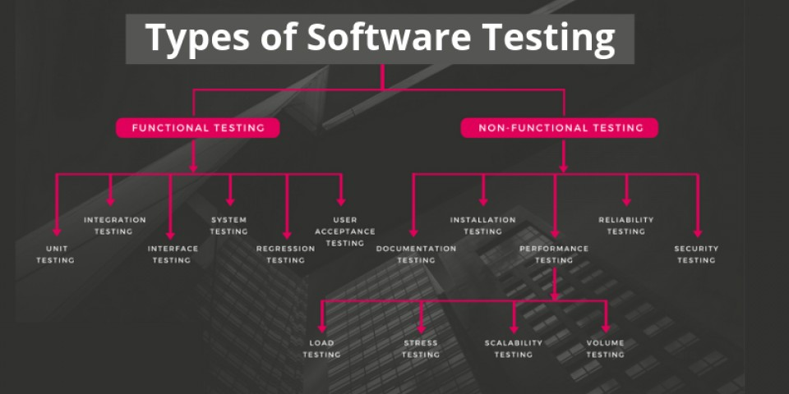

Slide 29
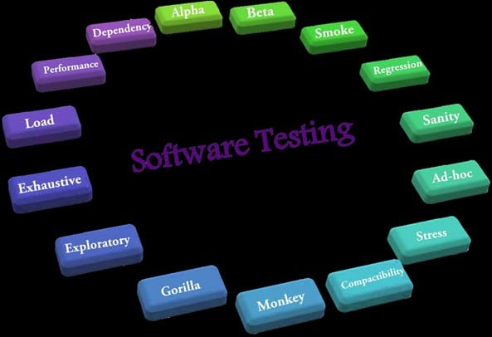

Slide 30
Alpha Testing
It is the most common type of testing used in the Software industry.
The objective of this testing is to identify all possible issues or defects before releasing it into the market or to the user.
Alpha Testing is carried out at the end of the software development phase but before the Beta Testing.
Still, minor design changes may be made as a result of such testing.
Alpha Testing is conducted at the developer’s site. In-house virtual user environment can be created for this type of testing.

Slide 31
Acceptance Testing
An Acceptance Test is performed by the client and verifies whether the end to end the flow of the system is as per the business requirements or not and if it is as per the needs of the end-user.
Client accepts the software only when all the features and functionalities work as expected.
It is the last phase of the testing, after which the software goes into production. This is also called User Acceptance Testing (UAT).

Slide 32
Accessibility Testing
The aim of Accessibility Testing is to determine whether the software or application is accessible for disabled people or not.
Here, disability means deaf, color blind, mentally disabled, blind, old age and other disabled groups.
Various checks are performed such as font size for visually disabled, color and contrast for color blindness, etc.

Slide 33
Beta Testing
Beta Testing is a formal type of Software Testing which is carried out by the customer.
It is performed in the Real Environment before releasing the product to the market for the actual end-users.
Beta Testing is carried out to ensure that there are no major failures in the software or product and it satisfies the business requirements from an end-user perspective.
Beta Testing is successful when the customer accepts the software.

Slide 34
Beta Testing
Usually, this testing is typically done by end-users or others.
It is the final testing done before releasing an application for commercial purpose.
Usually, the Beta version of the software or product released is limited to a certain number of users in a specific area.
So end-user actually uses the software and shares the feedback to the company.
Company then takes necessary action before releasing the software to the worldwide.

Slide 35
Back-end Testing
Whenever an input or data is entered on front-end application, it stores in the database and the testing of such database is known as Database Testing or Backend Testing.
There are different databases like SQL Server, MySQL, and Oracle, etc.
Database Testing involves testing of table structure, schema, stored procedure, data structure and so on.
In Back-end Testing GUI is not involved, testers are directly connected to the database with proper access and testers can easily verify data by running a few queries on the database.

Slide 36
Back-end Testing
There can be issues identified like data loss, deadlock, data corruption etc during this back-end testing and these issues are critical to fixing before the system goes live into the production environment

Slide 37
Browser Compatibility Testing
It is a subtype of Compatibility Testing (which is explained below) and is performed by the testing team.
Browser Compatibility Testing is performed for web applications and it ensures that the software can run with the combination of different browser and operating system.
This type of testing also validates whether web application runs on all versions of all browsers or not.

Slide 38
Backward Compatibility Testing
It is a type of testing which validates whether the newly developed software or updated software works well with the older version of the environment or not.
Backward Compatibility Testing checks whether the new version of the software works properly with file format created by an older version of the software;
It also works well with data tables, data files, data structure created by the older version of that software.

Slide 39
Black Box Testing
Internal system design is not considered in this type of testing. Tests are based on the requirements and functionality.

Slide 40
Boundary Value Testing
Boundary Value Testing is performed for checking if defects exist at boundary values.
Boundary Value Testing is used for testing a different range of numbers.
There is an upper and lower boundary for each range and testing is performed on these boundary values.
If testing requires a test range of numbers from 1 to 500 then Boundary Value Testing is performed on values at 0, 1, 2, 499, 500 and 501.

Slide 41
Branch Testing
It is a type of White box Testing and is carried out during Unit Testing.
Branch Testing, the name itself suggests that the code is tested thoroughly by traversing at every branch.

Slide 42
Comparison Testing
Comparison of a product's strength and weaknesses with its previous versions or other similar products is termed as Comparison Testing.

Slide 43
Compatibility Testing
It is a testing type in which it validates how software behaves and runs in a different environment, web servers, hardware, and network environment.
Compatibility testing ensures that software can run on a different configuration, different database, different browsers, and their versions.
Compatibility testing is performed by the testing team.

Slide 44
Component Testing
It is mostly performed by developers after the completion of unit testing.
Component Testing involves testing of multiple functionalities as a single code and its objective is to identify if any defect exists after connecting those multiple functionalities with each other.

Slide 45
End-to-End Testing
Similar to system testing, End-to-End Testing involves testing of a complete application environment in a situation that mimics real-world use, such as interacting with a database, using network communications, or interacting with other hardware, applications, or systems if appropriate.

Slide 46
Functional Testing
This type of testing ignores the internal parts and focuses only on the output to check if it is as per the requirement or not.
It is a Black-box type testing geared to the functional requirements of an application.

Slide 47
Graphical User Interface (GUI) Testing
The objective of this GUI Testing is to validate the GUI as per the business requirement.
The expected GUI of the application is mentioned in the Detailed Design Document and GUI mockup screens.
The GUI Testing includes the size of the buttons and input field present on the screen, alignment of all text, tables, and content in the tables.
It also validates the menu of the application, after selecting different menu and menu items, it validates that the page does not fluctuate and the alignment remains same after hovering the mouse on the menu or sub-menu.

Slide 48
Gorilla Testing
Gorilla Testing is a testing type performed by a tester and sometimes by the developer the as well.
In Gorilla Testing, one module or the functionality in the module is tested thoroughly and heavily.
The objective of this testing is to check the robustness of the application.

Slide 49
Happy Path Testing
The objective of Happy Path Testing is to test an application successfully on a positive flow.
It does not look for negative or error conditions.
The focus is only on the valid and positive inputs through which application generates the expected output.

Slide 50
Incremental Integration Testing
Incremental Integration Testing is a Bottom-up approach for testing i.e continuous testing of an application when new functionality is added.
Application functionality and modules should be independent enough to test separately.
This is done by programmers or by testers.

Slide 51
Install/Uninstall Testing
Installation and Uninstallation Testing is done on full, partial, or upgrade install/uninstall processes on different operating systems under different hardware or software environment.

Slide 52
Integration Testing
Testing of all integrated modules to verify the combined functionality after integration is termed as Integration Testing.
Modules are typically code modules, individual applications, client and server applications on a network, etc.
This type of testing is especially relevant to client/server and distributed systems.

Slide 53
Load Testing
It is a type of Non-Functional Testing and the objective of Load Testing is to check how much load or maximum workload a system can handle without any performance degradation.
Load Testing helps to find the maximum capacity of the system under specific load and any issues that cause software performance degradation.
Load testing is performed using tools like JMeter, LoadRunner, WebLoad, Silk performer, etc.

Slide 54
Monkey Testing
Monkey Testing is carried out by a tester assuming that if the monkey uses the application then how random input, values will be entered by the Monkey without any knowledge or understanding of the application.
The objective of Monkey Testing is to check if an application or system gets crashed by providing random input values/data.
Monkey Testing is performed randomly and no test cases are scripted and it is not necessary too.
Monkey Testing is performed randomly and no test cases are scripted and it is not necessary to be aware of the full functionality of the system.

Slide 55
Mutation Testing
Mutation Testing is a type of white box testing in which the source code of one of the program is changed and verifies whether the existing test cases can identify these defects in the system.
The change in the program source code is very minimal so that it does not impact the entire application, only the specific area having the impact and the related test cases should able to identify those errors in the system.

Slide 56
Negative Testing
Testers having the mindset of “attitude to break” and using Negative Testing they validate that if system or application breaks.
A Negative Testing technique is performed using incorrect data, invalid data or input.
It validates that if the system throws an error of invalid input and behaves as expected.

Slide 57
Non-Functional Testing
It is a type of testing for which every organization having a separate team which usually called as Non-Functional Test (NFT) team or Performance team.
Non-Functional Testing involves testing of non-functional requirements such as Load Testing, Stress Testing, Security, Volume, Recovery Testing, etc.
The objective of NFT testing is to ensure whether the response time of software or application is quick enough as per the business requirement.
It should not take much time to load any page or system and should sustain during peak load.

Slide 58
Performance Testing
This term is often used interchangeably with ‘stress' and ‘load' testing. Performance Testing is done to check whether the system meets the performance requirements.
Different performance and load tools are used to do this testing.

Slide 59
Recovery Testing
It is a type of testing which validates how well the application or system recovers from crashes or disasters.
Recovery Testing determines if the system is able to continue the operation after a disaster.
Assume that application is receiving data through the network cable and suddenly that network cable has been unplugged.
Sometime later, plug the network cable; then the system should start receiving data from where it lost the connection due to network cable unplugged.

Slide 60
Regression Testing
Testing an application as a whole for the modification in any module or functionality is termed as Regression Testing.
It is difficult to cover all the system in Regression Testing, so typically Automation Testing Tools are used for these types of testing.

Slide 61
Risk-Based Testing (RBT)
In Risk-Based Testing, the functionalities or requirements are tested based on their priority.
Risk-Based Testing includes testing of highly critical functionality, which has the highest impact on business and in which the probability of failure is very high.
The priority decision is based on the business need, so once priority is set for all functionalities then high priority functionality or test cases are executed first followed by medium and then low priority functionalities.
The low priority functionality may be tested or not tested based on the available time.
The Risk-Based Testing is carried out if there is insufficient time available to test entire software and software needs to be implemented on time without any delay.
This approach is followed only by the discussion and approval of the client and senior management of the organization.

Slide 62
Sanity Testing
Sanity Testing is done to determine if a new software version is performing well enough to accept it for a major testing effort or not.
If an application is crashing for the initial use then the system is not stable enough for further testing. Hence a build or an application is assigned to fix it.

Slide 63
Security Testing
It is a type of testing performed by a special team of testers. A system can be penetrated by any hacking way.
Security Testing is done to check how the software or application or website is secure from internal and external threats.
This testing includes how much software is secure from the malicious program, viruses and how secure and strong the authorization and authentication processes are.
It also checks how software behaves for any hackers attack and malicious programs and how software is maintained for data security after such a hacker attack.

Slide 64
Smoke Testing
Whenever a new build is provided by the development team then the Software Testing team validates the build and ensures that no major issue exists.
The testing team ensures that the build is stable and a detailed level of testing is carried out further.
Smoke Testing checks that no show stopper defect exists in the build which will prevent the testing team to test the application in detail.
If testers find that the major critical functionality is broken down at the initial stage itself then testing team can reject the build and inform accordingly to the development team.
Smoke Testing is carried out to a detailed level of any Functional or Regression Testing.

Slide 65
Static Testing
Static Testing is a type of testing which is executed without any code.
The execution is performed on the documentation during the testing phase.
It involves reviews, walkthrough, and inspection of the deliverables of the project.
Static Testing does not execute the code instead of the code syntax, naming conventions are checked.
Static Testing is also applicable for test cases, test plan, design document.
It is necessary to perform static testing by the testing team as the defects identified during this type of testing are cost-effective from the project perspective.

Slide 66
Stress Testing
This testing is done when a system is stressed beyond its specifications in order to check how and when it fails.
This is performed under heavy load like putting large number beyond storage capacity, complex database queries, continuous input to the system or database load.

Slide 67
System Testing
Under System Testing technique, the entire system is tested as per the requirements.
It is a Black-box type Testing that is based on overall requirement specifications and covers all the combined parts of a system.

Slide 68
Unit Testing
Testing of an individual software component or module is termed as Unit Testing.
It is typically done by the programmer and not by testers, as it requires detailed knowledge of the internal program design and code.
It may also require developing test driver modules or test harnesses.

Slide 69
Usability Testing
Under Usability Testing, User-friendliness check is done.
The application flow is tested to know if a new user can understand the application easily or not, Proper help documented if a user gets stuck at any point.
Basically, system navigation is checked in this testing.

Slide 70
Vulnerability Testing
The testing which involves identifying weakness in the software, hardware and the network is known as Vulnerability Testing.
Malicious programs, the hacker can take control of the system, if it is vulnerable to such kind of attacks, viruses, and worms.
So it is necessary to check if those systems undergo Vulnerability Testing before production.
It may identify critical defects, flaws in the security.

Slide 71
Volume Testing
Volume Testing is a type of Non-Functional Testing performed by the Performance Testing team.
The software or application undergoes a huge amount of data and Volume Testing checks the system behavior and response time of the application when the system came across such a high volume of data.
This high volume of data may impact the system’s performance and speed of the processing time.

Slide 72
White Box Testing
White Box Testing is based on the knowledge about the internal logic of an application's code.
It is also known as Glass box Testing. Internal software and code working should be known for performing this type of testing.
Under these tests are based on the coverage of code statements, branches, paths, conditions, etc.

Slide 73
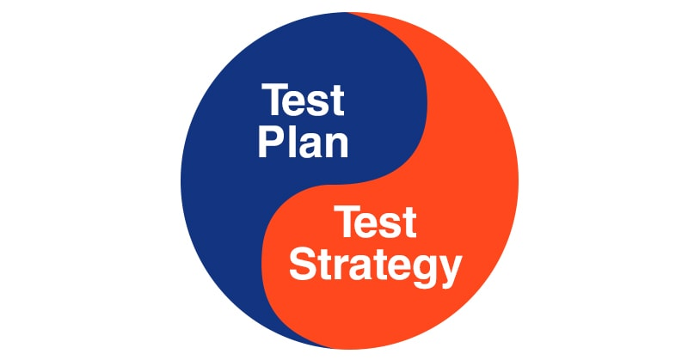

Slide 74
Test Planning
Test Planning is the most important phase of Software testing life cycle where all testing strategy is defined.
In this phase, the Test Manager is involved to determine the effort and cost estimates for the entire project.
It defines the objective & scope of the project.

Slide 75
Test Planning
Test plan is one of the most important steps in software testing life cycle. The steps involved in writing a test plan include :
Analyze the product
Design Test Strategy
Define Test Objectives
Define Test Criteria
Resource Planning
Plan Test Environment
Schedule & Estimation
Determine Test Deliverable.

Slide 76
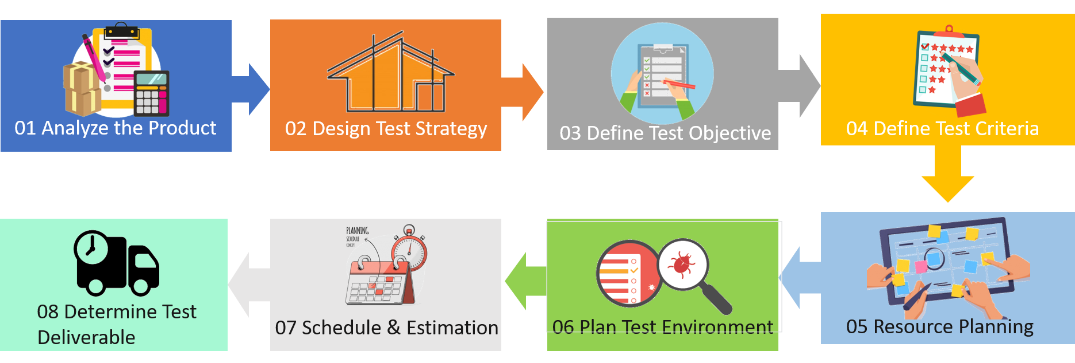
Test Planning

Slide 77
Test Planning
The Test Plan – defines the scope of the work to be performed
The Test Procedure – a container document that holds all of the individual tests (test scripts) that are to be executed
The Test Report – documents what occurred when the test scripts were run

Slide 78
Test Plan
Questions to be answered:
How many tests are needed?
How long will it take to develop those tests?
How long will it take to execute those tests?
Topics to be addressed:
Test estimation
Test development and informal validation
Validation readiness review and formal validation
Test completion criteria

Slide 79
Test Estimation
Number of test cases required is based on:
Testing all functions and features in the SRS
Including an appropriate number of ALAC (Act Like A Customer) tests including:
Do it wrong
Use wrong or illegal combination of inputs
Don’t do enough
Do nothing
Do too much
Achieving some test coverage goal
Achieving a software reliability goal

Slide 80
Considerations in Test Estimation
Test Complexity – It is better to have many small tests that a few large ones.
Different Platforms – Does testing need to be modified for different platforms, operating systems, etc.
Automated or Manual Tests – Will automated tests be developed? Automated tests take more time to create but do not require human intervention to run.

Slide 81
Estimating Tests Required
SRS Reference | Estimated Number of Tests Required | Notes
4.1.1 | 3 | 2 positive and 1 negative test
4.1.2 | 2 | 2 automated tests
4.1.3 | 4 | 4 manual tests
4.1.4 | 5 | 1 boundary condition, 2 error conditions, 2 usability tests
…
Total | 165

Slide 82
Estimated Test Development Time
Estimated Number of Tests: 165
Average Test Development Time: 3.5
(person-hours/test)
Estimated Test Development Time: 577.5
(person-hours)

Slide 83
Estimated Test Execution Time
Estimated Number of Tests: 165
Average Test Execution Time: 1.5
(person-hours/test)
Estimated Test Execution Time: 247.5
(person-hours)
Estimated Regression Testing (50%): 123.75
(person-hours)
Total Estimated Test Execution Time: 371.25
(person-hours)

Slide 84
Test Procedure
Collection of test scripts
An integral part of each test script is the expected results
The Test Procedure document should contain an unexecuted, clean copy of every test so that the tests may be more easily reused

Slide 85
Test Strategy
A Test Strategy is a plan for defining the testing approach, and it answers to questions like what you want to get done and how you are going to accomplish it.
It is most important document for any QA team in software testing, and effectively writing this document is a skill that every tester develops with experience.

Slide 86
Test Strategy
Test strategy is a guideline to be followed to achieve the test objective and execution of test types mentioned in the testing plan.
It deals with test objective, test environment, test approach, automation tools and strategy, contingency plan, and risk analysis

Slide 87
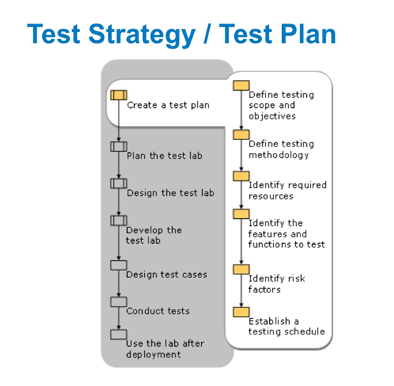

Slide 88
Test Strategy
Testing Strategies include:
Leave time for fixing: Once problems are discovered, it is important to fix the time for the developers to resolve the issues.
Also, the company needs time to retest the fixes as well.
Discourage passing the buck: If we want to minimize back and forth conversations between developers and testers, we need to develop a culture that will encourage them to hop on the phone or have desk-side chat to get to the bottom of things.
Testing and fixing are all about collaboration.

Slide 89

Test Strategy
Manual testing has to be exploratory: If it is possible to write down or script any issue in exact terms, it could be automated and belongs in the automated test suite.
Real-world use of the software will not be scripted and the testers need to break things without a script.

Slide 90
Test Strategy
Encourage clarity: We need to create a bug report that provides clarity rather than creating any confusion.
However, it is also integral for a developer to go out of the way to effectively communicate as well.
Test often: This helps in preventing huge backlogs of problems from building up and crushing morale. Frequent testing is considered the best approach.
These are some of the software testing strategies that will help us in running the development process smoothly.

Slide 91
Factors affecting Software Testing Strategies
Risks- Risk management is very important during testing to figure out the risks and the risk level. For example, for an app that is well-established and slowly evolving, regression is a critical risk.
Objectives- Testing should satisfy the requirements and needs of stakeholders to succeed. The objective is to look for as many defects as possible with less up-front time and effort invested.

Slide 92
Factors affecting Software Testing Strategies
Skills- It is important to consider the skills of the testers since strategies should not only be chosen but executed as well. A standard-compliant strategy is a smart option when lacking skills and time in the team to create an approach.
Product- Some products have specified requirements. This could lead to synergy with an analytical strategy that is requirements-based.

Slide 93
Factors affecting Software Testing Strategies
Business- Business considerations and strategy are often important. If using a legacy system as a model for a new one, you could use a model-based strategy.
Regulations- At some instances, one needs to satisfy the regulators along with the stakeholders. In this case, you would need a methodical strategy which satisfies these regulators.

Slide 94
How to prepare a good test strategy document
Every organization has their unique priority and set of rules for software designing, so do not copy any organization blindly.
Always ensure that their document is compatible and adds value to your software development before following the template.

Slide 95
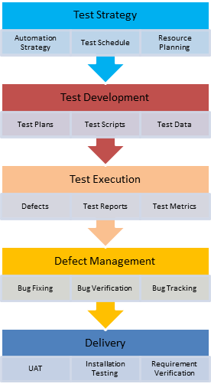
How to prepare a good test strategy document

Slide 96
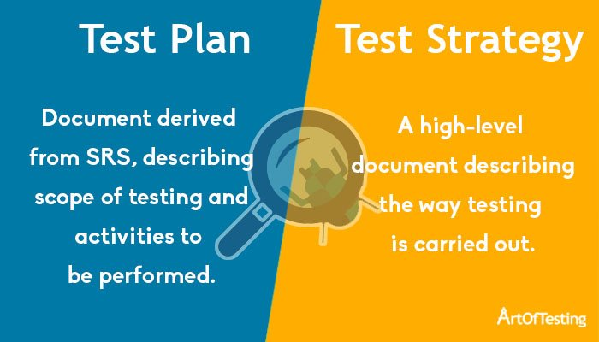
Test Strategy

Slide 97
Test Plan | Test Strategy
A Test Plan for the software project is a document that defines the scope, objective, approach, and emphasis more on the software testing efforts. | Test Strategy is defined as the set of guidelines that explain the test design and regulates how testing needs to be done.
The major components of Test Plan include – Test Plan ID, test environment, features to be tested, entry/exit criteria, status, type of testing, brief introduction etc. We will discuss each of these components in detail below. | The major components of Test Strategy include – Scope, Objective, business issues, risks, testing approach, testing deliverables, defect tracking, training, automation etc. We will discuss each of these components in detail below.
A Test Plan is developed by the project manager or test lead. | A Test Strategy is developed by the business analyst or project manager.
Test plan narrates about the specification and it can be changed frequently. | Test Strategy narrates about the general approaches and it not updated often.
A Test Plan usually exists individually. | Test strategy is divided into multiple test plans that are taken care further independently.
It is defined at the project level. | It is defined at the organization level.
Test planning helps to identify the possible risks or issues. | A test strategy helps to abstract information that does not project specific but it can be used with the test approach.

Slide 98
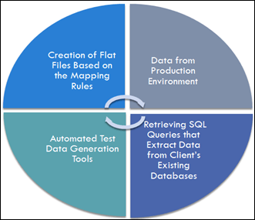
Strategies for Test Data Management (TDM)

Slide 99
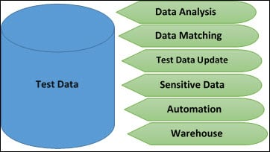
Strategies for Test Data Management (TDM)

Slide 100
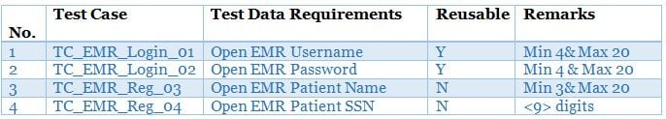
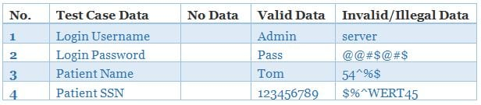
Strategies for Test Data Management (TDM)

Slide 101
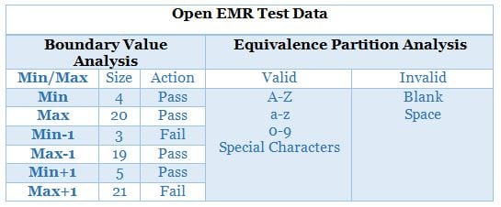
Strategies for Test Data Management (TDM)

Slide 102
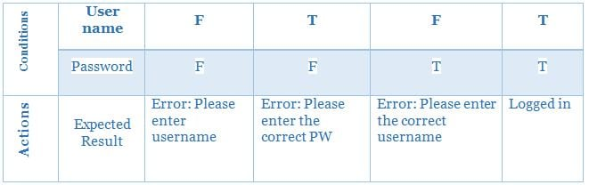
Strategies for Test Data Management (TDM)

Slide 103
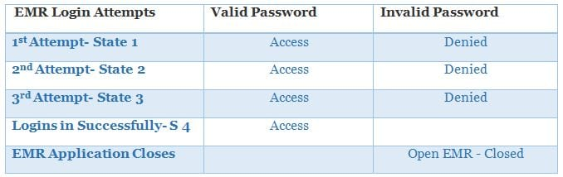
Strategies for Test Data Management (TDM)

Slide 104
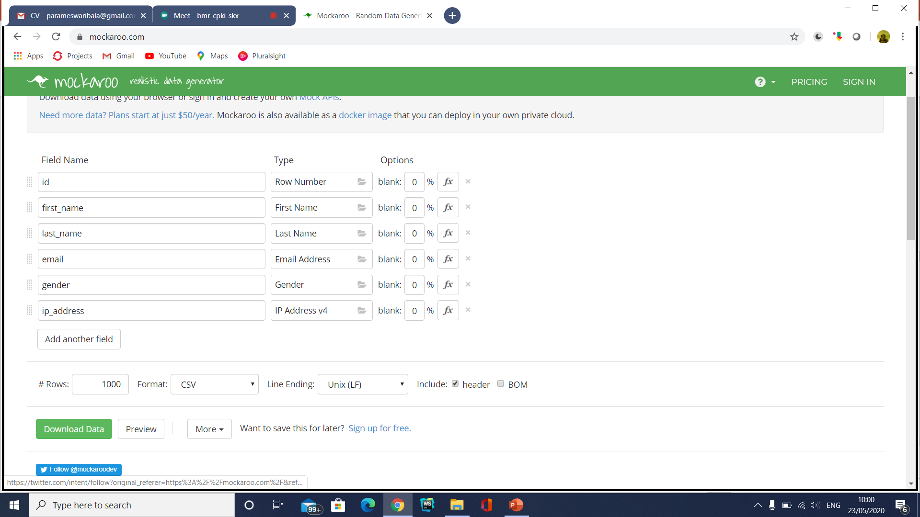
Test Data Generation Tools

Slide 105
Defect Report
DEFECT REPORT is a document that identifies and describes a defect detected by a tester.
The purpose of a defect report is to state the problem as clearly as possible so that developers can replicate the defect easily and fix it.

Slide 106
Defect Report Template
ID | Unique identifier given to the defect. (Usually, automated)
Project | Project name.
Product | Product name.
Release Version | Release version of the product. (e.g. 1.2.3)
Module | Specific module of the product where the defect was detected.
Detected Build Version | Build version of the product where the defect was detected (e.g. 1.2.3.5)
Summary | Summary of the defect. Keep this clear and concise.
Description | Detailed description of the defect. Describe as much as possible but without repeating anything or using complex words. Keep it simple but comprehensive.

Slide 107
Defect Report Template
Steps to Replicate | Step by step description of the way to reproduce the defect. Number the steps.
Actual Result | The actual result you received when you followed the steps.
Expected Results | The expected results.
Attachments | Attach any additional information like screenshots and logs.
Remarks | Any additional comments on the defect.
Defect Severity | Severity of the Defect.
Defect Priority | Priority of the Defect.
Reported By | The name of the person who reported the defect.
Assigned To | The name of the person that is assigned to analyze/fix the defect.
Status | The status of the defect.
Fixed Build Version | Build version of the product where the defect was fixed (e.g. 1.2.3.9)

Slide 108
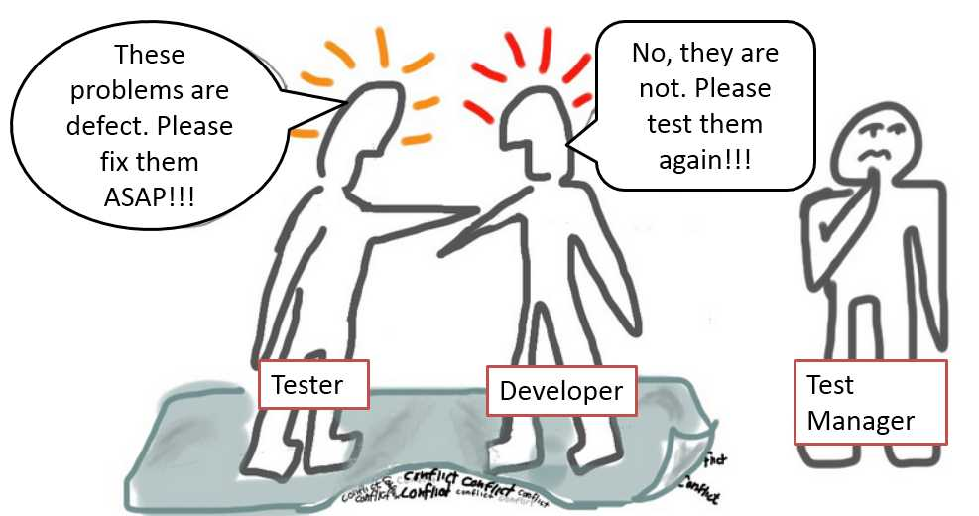

Slide 109
Defect Report
In such case, as a Test Manager, what will you do?
A) Agree With the test team that its a defect
B) Test Manager takes the role of judge to decide whether the problem is defect or not
C) Agree with the development team that is not a defect

Slide 110
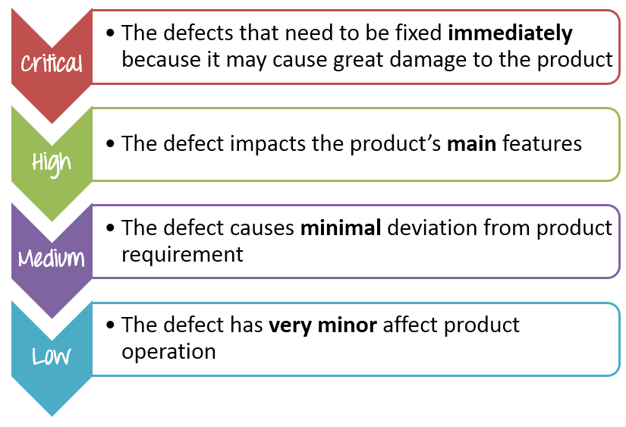
Defect Categorization

Slide 111
Defect Categorization
No. | Description | Priority | Explanation
1 | The website performance is too slow | High | The performance bug can cause huge inconvenience to user.
2 | The login function of the website does not work properly | Critical | Login is one of the main function of the banking website if this feature does not work, it is serious bugs
3 | The GUI of the website does not display correctly on mobile devices | Medium | The defect affects the user who use Smartphone to view the website.
4 | The website could not remember the user login session | High | This is a serious issue since the user will be able to login but not be able to perform any further transactions
5 | Some links doesn’t work | Low | This is an easy fix for development guys and the user can still access the site without these links

Slide 112
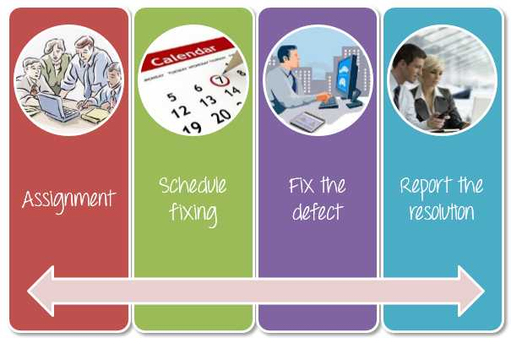
Resolution

Slide 113
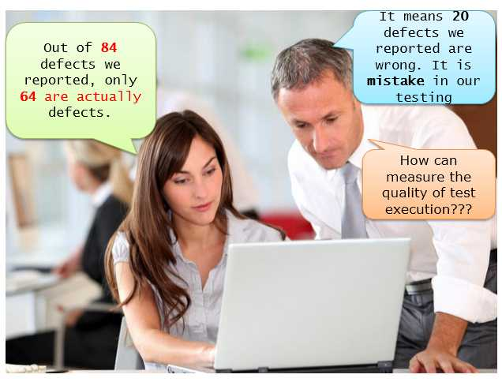
Important Defect Metrics

Slide 114
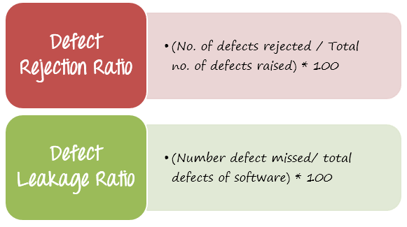
How to measure and evaluate the quality of the test execution?

Slide 115
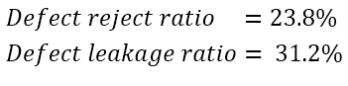
How to measure and evaluate the quality of the test execution?

Slide 116
Good Testing Practices
A good test case is one that has a high probability of detecting an undiscovered defect, not one that shows that the program works correctly
It is impossible to test your own program
A necessary part of every test case is a description of the expected result

Slide 117
Good Testing Practices (cont’d)
Avoid non reproducible or on-the-fly testing
Write test cases for valid as well as invalid input conditions.
Thoroughly inspect the results of each test
As the number of detected defects in a piece of software increases, the probability of the existence of more undetected defects also increases

Slide 118
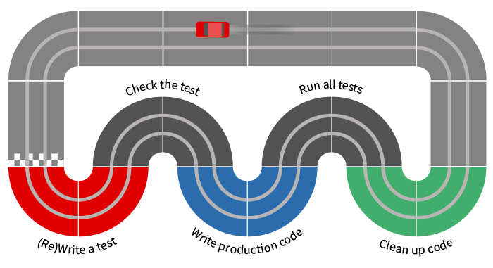
TDD

Slide 119
What is TDD
Test-Driven Development (TDD) is a technique for building software that guides software development by writing tests. (Martin Fowler’s definition)
“Test Driven Development” is NOT primarily about testing or development (i.e., coding)
It is rather about design - where design is evolved through refactoring
Developers write unit tests (NOT testers) and then code

Slide 120
What is TDD
The primary goal of TDD is to make the code clearer, simple and bug-free.
Test-Driven Development starts with designing and developing tests for every small functionality of an application.
In TDD approach, first, the test is developed which specifies and validates what the code will do.

Slide 121
Old Approach

Slide 122
New Approach

Slide 123
TDD? But I already write unit tests!
The simple concept of TDD is to write and correct the failed tests before writing new code (before development).
This helps to avoid duplication of code as we write a small amount of code at a time in order to pass tests.
Tests are nothing but requirement conditions that we need to test to fulfill them.
Test-Driven development is a process of developing and running automated test before actual development of the application.
Hence, TDD sometimes also called as Test First Development.

Slide 124
Why TDD
TDD as a technique for specifying your requirements and design before writing the actual program code.
The second view takes a more pragmatic approach and sees TDD as a technique that helps programmers write better code.
Regardless of the view one takes, what TDD practitioners all agree on is that TDD will not only improve your code, but it will also improve the overall design and implementation of your software system.

Slide 125
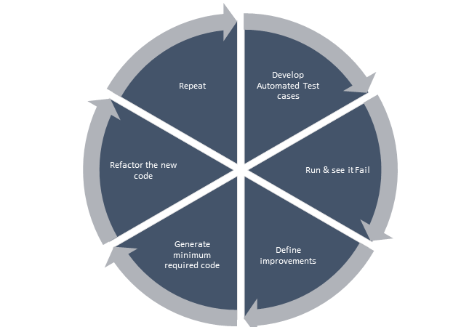
Why TDD

Slide 126
Why TDD
Reduce development costs
Cut down time to market in the development process
Improve programmer’s productivity
Develop a neat code that is well-defined
Cut down turnaround time
Generates proof that the developed code works as expected
Boosts the process of generating quality code

Slide 127
Why TDD
A significant advantage of TDD is that it enables you to take small steps when writing software.
This is a practice that I have promoted for years because it is far more productive than attempting to code in large steps.
For example, assume you add some new functional code, compile, and test it.
Chances are pretty good that your tests will be broken by defects that exist in the new code.
It is much easier to find, and then fix, those defects if you've written two new lines of code than two thousand.

Slide 128
Why TDD
The implication is that the faster your compiler and regression test suite, the more attractive it is to proceed in smaller and smaller steps.
I generally prefer to add a few new lines of functional code, typically less than ten, before I recompile and rerun my tests.

Slide 129
TDD mantra

Slide 130
TDD mantra
Red—write a little test that doesn’t work, perhaps doesn’t even compile at first
Green—make the test work quickly, committing whatever sins necessary in the process
Refactor—eliminate all the duplication and smells created in just getting the test to work

Slide 131
3 laws of TDD
Law 1: You may not write production code unless you’ve first written a failing unit test.
Law 2: You may not write more of a unit test than is sufficient to fail.
Law 3: You may not write more production code than is sufficient to make the failing unit test pass.

Slide 132
TDD Benefits
Early bug notification
Developers test their code but in the database world, this often consists of manual tests or one-off scripts.
Using TDD you build up, over time, a suite of automated tests that you and any other developer can rerun at will.
Better Designed, cleaner and more extensible code.
It helps to understand how the code will be used and how it interacts with other modules.
It results in better design decision and more maintainable code.

Slide 133
TDD Benefits
TDD allows writing smaller code having single responsibility rather than monolithic procedures with multiple responsibilities. This makes the code simpler to understand.
TDD also forces to write only production code to pass tests based on user requirements.

Slide 134
TDD Benefits
Confidence to Refactor
If you refactor code, there can be possibilities of breaks in the code. So having a set of automated tests you can fix those breaks before release.
Proper warning will be given if breaks found when automated tests are used.
Using TDD, should results in faster, more extensible code with fewer bugs that can be updated with minimal risks.
Good for teamwork In the absence of any team member, other team members can easily pick up and work on the code. It also aids knowledge sharing, thereby making the team more effective overall.
Good for Developers Though developers have to spend more time in writing TDD test cases, it takes a lot less time for debugging and developing new features. You will write cleaner, less complicated code.

Slide 135
TDD Benefits

Slide 136
Impact of Adopting TDD
Using TDD to produce code means that developers begin by setting out exactly what the code should do rather than beginning with how the code should satisfy the requirement.
The advantage of this is that the developer is focused on what the code needs to achieve from the outset rather than writing code in a more generalised way.
At Boost found that continuous testing quite naturally results in fewer defects and TTD results in a greater understanding of what the code should achieve as well as cleaner code.

Slide 137
How Do I Adopt TDD
Add a test.
Run all tests and see if any new test fails.
Write some code.
Run tests and Refactor code.
Repeat.

Slide 138
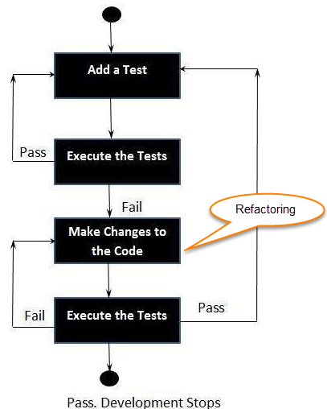
How Do I Adopt TDD

Slide 139
What is acceptance TDD and Developer TDD
Acceptance TDD (ATDD):
With ATDD you write a single acceptance test.
This test fulfills the requirement of the specification or satisfies the behavior of the system.
After that write just enough production/functionality code to fulfill that acceptance test.
Acceptance test focuses on the overall behavior of the system.
ATDD also was known as Behavioral Driven Development (BDD).

Slide 140
What is acceptance TDD and Developer TDD
Developer TDD
With Developer TDD you write single developer test i.e. unit test and then just enough production code to fulfill that test.
The unit test focuses on every small functionality of the system.
Developer TDD is simply called as TDD.
The main goal of ATDD and TDD is to specify detailed, executable requirements for your solution on a just in time (JIT) basis.
JIT means taking only those requirements in consideration that are needed in the system. So increase efficiency.

Slide 141
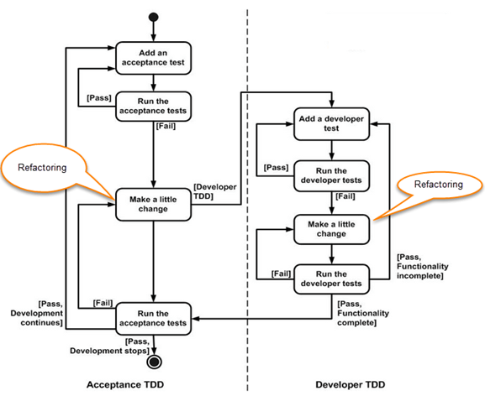
What is acceptance TDD and Developer TDD

Slide 142
How Do I Adopt TDD

Slide 143
TDD Design Patterns
Pass/Fail Patterns
These patterns are your first line of defence (or attack, depending on your perspective) to guarantee good code.
But be warned, they are deceptive in what they tell you about the code.
The Simple-Test Pattern
The Code-Path Pattern
The Parameter-Range Pattern

Slide 144
TDD Design Patterns
Data Transaction Patterns
Data transaction patterns are a start at embracing the issues of data persistence and communication.
These patterns intentionally omit stress testing, for example, loading on the server
The Simple-Data-I/O Pattern
The Constraint-Data Pattern
The Rollback Pattern

Slide 145
TDD Design Patterns
Collection Management Patterns
A lot of what applications do is manage collections of information. While there are a variety of collections available to the programmer, it is important to verify that the code is using the correct collection.
This affects ordering and constraints.
The Collection-Order Pattern
The Enumeration Pattern The
Collection-Constraint Pattern
The Collection-Indexing Pattern

Slide 146
TDD Design Patterns
Performance Patterns
Unit testing should not just be concerned with function but also with form.
How efficiently does the code under test perform its function? How fast? How much memory does it use?
Does it trade off data insertion for data retrieval effectively? Does it free up resources correctly?
These are all things that are under the purview of unit testing.
By including performance patterns in the unit test, the implementer has a goal to reach, which results in better code, a better application, and a happier customer.
The Performance-Test Pattern

Slide 147
TDD Design Patterns
Process Patterns
Unit testing is intended to test, well, units...the basic functions of the application.
It can be argued that testing processes should be relegated to the acceptance test procedures, however I don't buy into this argument.
A process is just a different type of unit.

Slide 148
TDD Design Patterns
Process Patterns
Testing processes with a unit tester provide the same advantages as other unit testing.
It documents the way the process is intended to work.
The unit tester can aid the implementer by also testing the process out of sequence, rapidly identifying potential user interface issues as well.
The term "process" also includes state transitions and business rules, both of which must be validated.
The Process-Sequence Pattern
The Process-State Pattern
The Process-Rule Pattern

Slide 149
TDD Design Patterns
Simulation Patterns
Data transactions are difficult to test because they often require a preset configuration, an open connection, and/or an online device (to name a few).
Mock objects can come to the rescue by simulating the database, web service, user event, connection, and/or hardware with which the code is transacting.
Mock objects can showcase failure conditions that are very difficult to reproduce in the real world--a lossy connection, a slow server, a failed network hub, etc.
Mock-Object Pattern
The Service-Simulation Pattern
The Bit-Error-Simulation Pattern
The Component-Simulation Pattern

Slide 150
TDD Design Patterns
Multithreading Patterns
Unit testing multithreaded applications is probably one of the most difficult things to do because we must set up a condition that by its very nature is intended to be asynchronous and therefore non-deterministic.
To perform many threading tests correctly, the unit tester application must itself execute tests as separate threads so that the unit tester isn't disabled when one thread ends up in a wait state
The Signalled Pattern
The Deadlock-Resolution Pattern

Slide 151
TDD Design Patterns
Stress-Test Patterns
Most applications are tested in ideal environments--the programmer is using a fast machine with little network traffic, using small datasets.
The real world is very different. Before something completely breaks, the application may suffer degradation and respond poorly or with errors to the user.
Unit tests that verify the code's performance under stress should be met with equal fervor (if not more) than unit tests in an ideal environment.
The Bulk-Data-Stress-Test Pattern
The Resource-Stress-Test Pattern
The Loading-Test Pattern

Slide 152
TDD Design Patterns
Presentation Layer Patterns
One of the most challenging aspects of unit testing is verifying that information is getting to the user right at the presentation layer itself.
The internal workings of the application are correctly setting presentation layer state.
Presentation layers are entangled with business objects, data objects, and control logic.
Unit testing the presentation layer must have separation of concerns.
Part of the solution involves developing an appropriate Model-View-Controller (MVC) architecture.
The MVC architecture provides a means to develop good design practices when working with the presentation layer.
The View-State Test Pattern
The Model-State Test Pattern

Slide 153
TDD Best Practises
Naming Conventions
Separate the implementation from the test code
Name test classes in a similar fashion as classes they test
Use descriptive names for test methods
Write the test before writing the implementation code
Only write new code when test is failing
Rerun all tests every time implementation code changes

Slide 154
TDD Best Practises
All tests should pass before new test is written
Refactor only after all tests are passing
Write the simplest code to pass the test
Write assertions first, act later
Minimize assertions in each test
Do not introduce dependencies between tests
Use mocks(reduce dependency)
Use setup and tear-down methods
Do not use base classes

Slide 155
TDD Tools
Visual Studio 2022
Nunit/XUnit Test Framework
Nunit Test Adapter
Moq Framework
Code Coverage Tools
Default Visual Studio Code Coverage
ReSharper’s dotCover
NCover
OpenCover
NCrunch
NDepend
DotCover(Jet Brains)

Slide 156
NUnit
NUnit is an open-source testing framework ported from JUnit.
The latest version of NUnit is NUnit3 that is rewritten with many new features and has support for a wide range of .NET platforms.
NUnit has been downloaded more than 126 million times from NuGet.org.
This shows the popularity of NUnit within the .NET user community.
It is a popular test framework used for test automation.

Slide 157
NUnit
Automation testing in NUnit can be performed using the Visual Studio GUI and the NUnit console (NUnit.ConsoleRunner).
NUnit framework uses an attribute/annotation style system like other test frameworks.

Slide 158
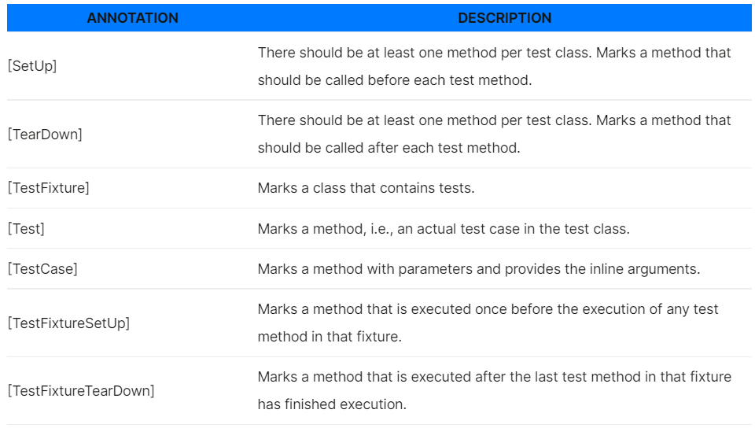
NUnit

Slide 159
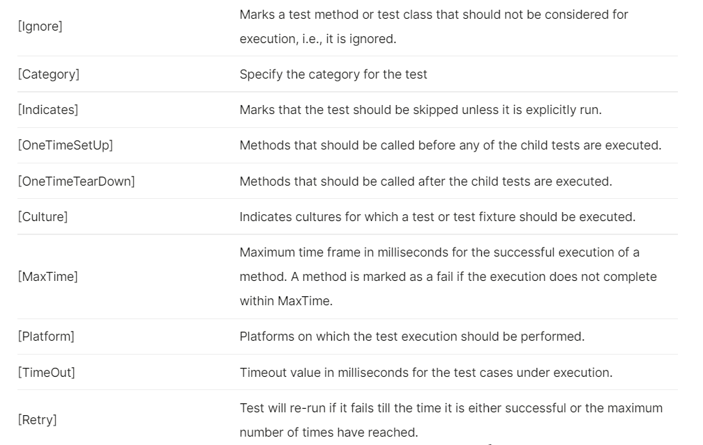
NUnit

Slide 160
NUnit
Using NUnit framework, tests can be executed serially as well as parallel.
Parallel test execution is possible at assembly, class, or method level.
When parallelism is enabled, by default four tests can be executed in parallel.
As Parallel test execution is supported in NUnit, it becomes a compelling option for Selenium automation testing and cross browser testing.

Slide 161
XUnit Testing
xUnit.net is a free, open source, community-focused unit testing tool for the .NET Framework.
Written by the original inventor of NUnit v2, xUnit.net is the latest technology for unit testing C#, F#, VB.NET and other .NET languages.
xUnit.net works with ReSharper, CodeRush, TestDriven.NET and Xamarin.
It is part of the .NET Foundation and operates under their code of conduct.
It is licensed under Apache 2 (an OSI approved license).

Slide 162
Why XUnit
NUnit was not fully compatible with .NET Core 2 at the time
We wanted to move away from MS Test, as the team preferred the xUnit and NUnit way of writing tests
xUnit is aimed at improving test isolation and trying to codify a set of rules to establish a testing standard.
xUnit [Fact] and [Theory] attributes are extensible, so you can implement your own testing functionality.
xUnit doesn’t use Test Lists and .vsmdi files to keep track of your tests.
Microsoft is using xUnit internally, one of its creators is from Microsoft. xUnit was also created by one of the original authors of NUnit.

Slide 163
Why XUnit
Isolation of Tests
xUnit framework provides much better isolation of tests in comparison to NUnit and MSTest frameworks.
For each test case, the test class is instantiated, executed, and is discarded after the execution.
This ensures that the tests can be executed in any order as there is reduced/no dependency between the tests.
Executing each test as a separate instance minimizes the chances of one test causing the other tests to fail!

Slide 164
Why XUnit
There is also an option to share setup/cleanup code that can be shared between different tests without the need to share object instances.

Slide 165
Why XUnit
Extensibility
When we do NUnit vs. XUnit vs. MSTest, extensibility plays an important role in choosing a particular test framework.
The choice might depend on the needs of the project, but in some scenarios, extensibility can turn the tables around for a particular test framework.

Slide 166
Why XUnit
Extensibility
When compared to MSTest and NUnit frameworks, xUnit framework is more extensible since it makes use of [Fact] and [Theory] attributes.
Many attributes that were present in NUnit framework e.g. [TestFixture], [TestFixtureSetup], [TestFixtureTearDown] [ClassCleanup], [ClassInitialize], [TestCleanup], etc. are not included in the xUnit framework.
Introduction of the [Theory] attribute for parameterized tests is one of the prime examples of the extensibility of the framework.
This also makes the implementation of custom functionality much easier in the xUnit framework.

Slide 167
Why XUnit
Initialization and De-initialization
The NUnit uses [SetUp], [TearDown] pairs whereas MSTest uses [TestInitialize], [TestCleanup] pairs for setting up the activities related to initialization & de-initialization of the test code.
On the other hand, xUnit uses the class constructor for the implementation of steps related to test initialization.
IDisposable interface for the implementation of steps related to de-initialization.
xUnit starts a new instance per test, whereas, in NUnit & MSTest frameworks, all the tests execute in the same Fixture/Class.

Slide 168
Why XUnit
Assertion mechanism
xUnit framework makes use of Assert.Throws instead of [ExpectedException] which is used in NUnit and MSTest.
The drawback of using [ExpectedException] is that the errors might not be reported if they occur in the wrong part of the code.
For example, if assert has to be raised for Security Exception, but Authentication Exception occurs, [ExpectedCondition] will not raise assert.

Slide 169
Why XUnit
Parallel test execution
All the three C# unit testing frameworks support parallel test execution and are well-suited for Selenium automation testing as throughput plays a major role in automation testing.
Below are the ways in which parallelism can be achieved in each of the test frameworks.

Slide 170
Why XUnit
NUnit – Parallelism is possible at the level of Children (child tests are executed in parallel with other tests), Fixtures (descendants of test till the level of Test Fixtures can execute in parallel), Self (test itself can be executed in parallel with other tests), and All (test & its descendants can execute in parallel with others at the same level).
[Parallelizable(ParallelScope.Children)]
[Parallelizable(ParallelScope.Fixtures)]
[Parallelizable(ParallelScope.Self)]
[Parallelizable(ParallelScope.All)]
[Parallelizable(ParallelScope.Children)]
[Parallelizable(ParallelScope.Fixtures)]
[Parallelizable(ParallelScope.Self)]
[Parallelizable(ParallelScope.All)]

Slide 171
Why XUnit
xUnit – Parallelism by putting the test classes into a single test collection or by executing an ‘n’ number of threads in parallel.
[assembly: CollectionBehavior(CollectionBehavior.CollectionPerAssembly)]
[assembly: CollectionBehavior(MaxParallelThreads = n)]
[assembly: CollectionBehavior(CollectionBehavior.CollectionPerAssembly)]
[assembly: CollectionBehavior(MaxParallelThreads = n)]

Slide 172
Why XUnit
There are no [Setup] and [Teardown] attributes, this is done using the test class’ constructor and an IDisposable.
This encourages developers to write cleaner tests.
xUnit allows us to write less code since its flexibility allows things like subspec which allow you to write only what you need to do.
Using tools such as xBehave: http://xbehave.github.io/ and Xunit.Gherkin.Quick.
xUnit is easier to read and uses intuitive terminology.

Slide 173
Xunit Packages
xunit
xunit.runner.visualstudio
Microsoft.NET.Test.Sdk

Slide 174
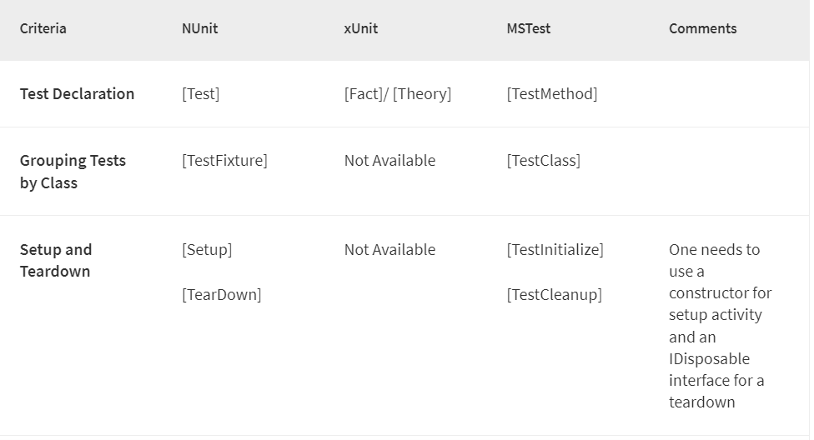
Nunit vs Xunit vs MSUnit

Slide 175
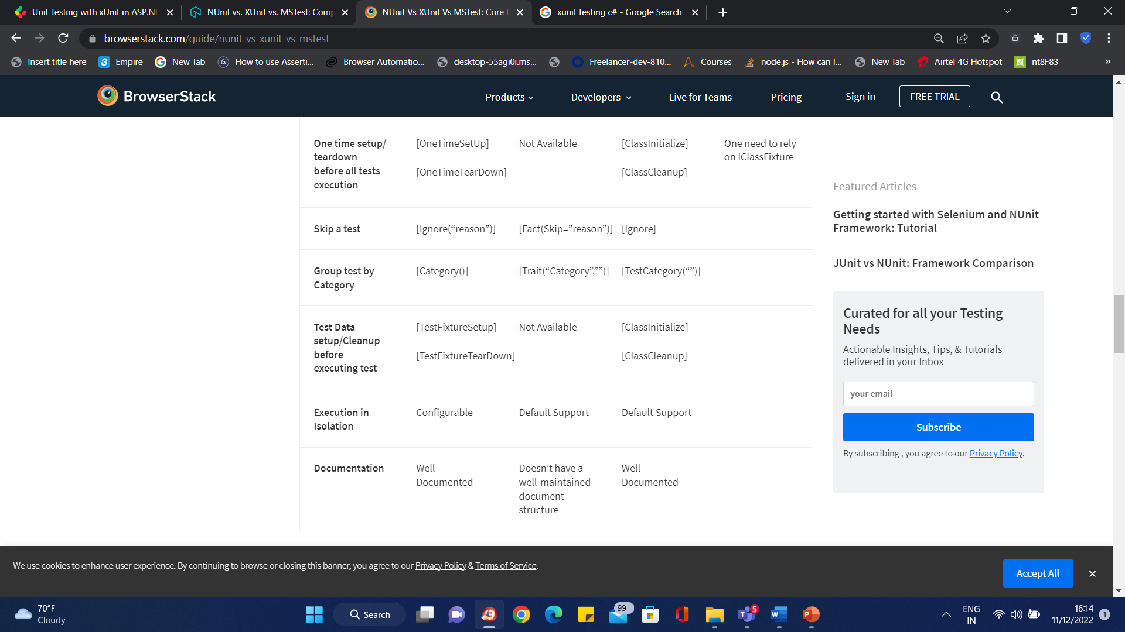
Nunit vs Xunit vs MSUnit

Slide 176
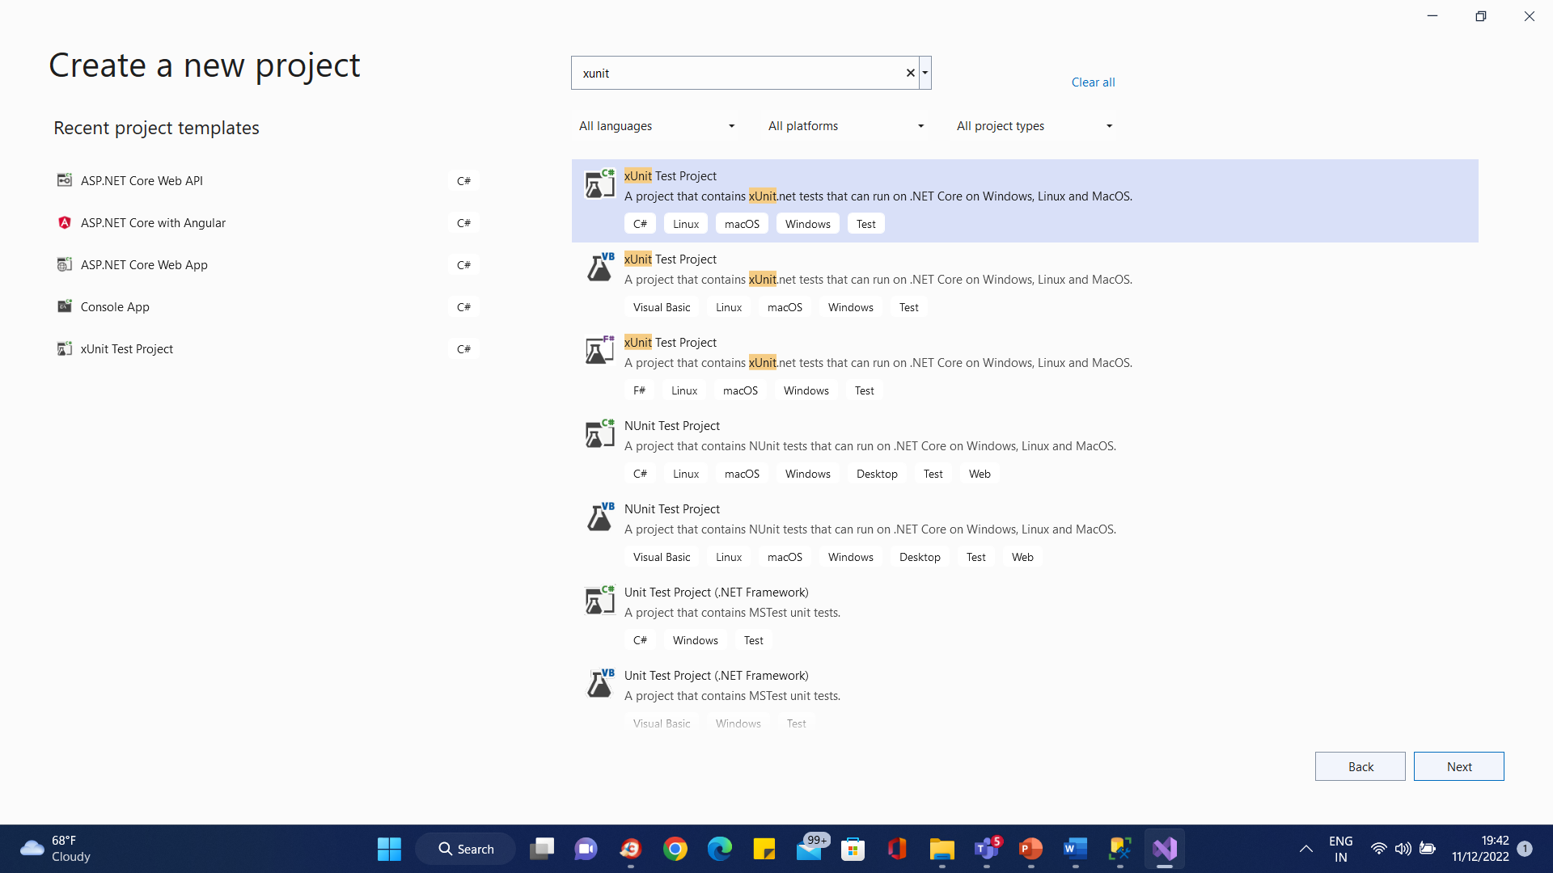
xUnit

Slide 177
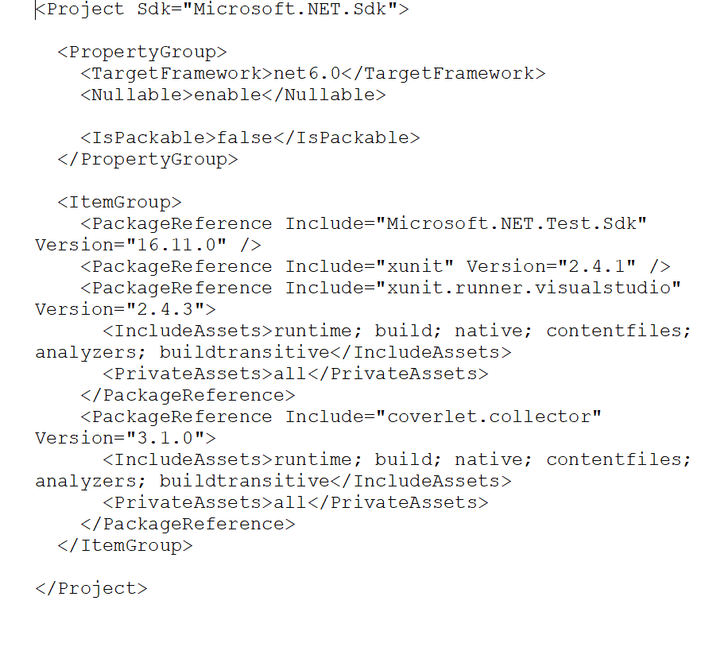
xUnit library

Slide 178
xUnit Fact
A Fact, in XUnit tests, is by definition a test method that has no inputs. Consequently, it is run as a single test: arrange once, act once, assert once.
//Fact tests do not take inputs.
//As a result, the result of the test should depend only on actions performed within the test
[Fact]
public void factExample() {
Assert.Equal((1 + 2), 3);
}

Slide 179
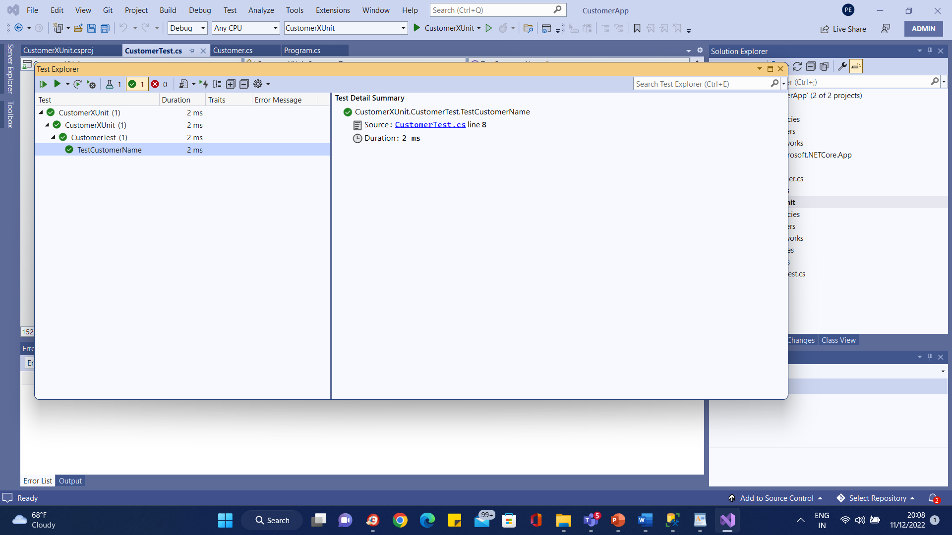
xUnit Test Explorer

Slide 180
xUnit Theory
A Theory in XUnit attribute specifies that a test method can have inputs, and that the method needs to be tested for many different combinations of inputs.

Slide 181
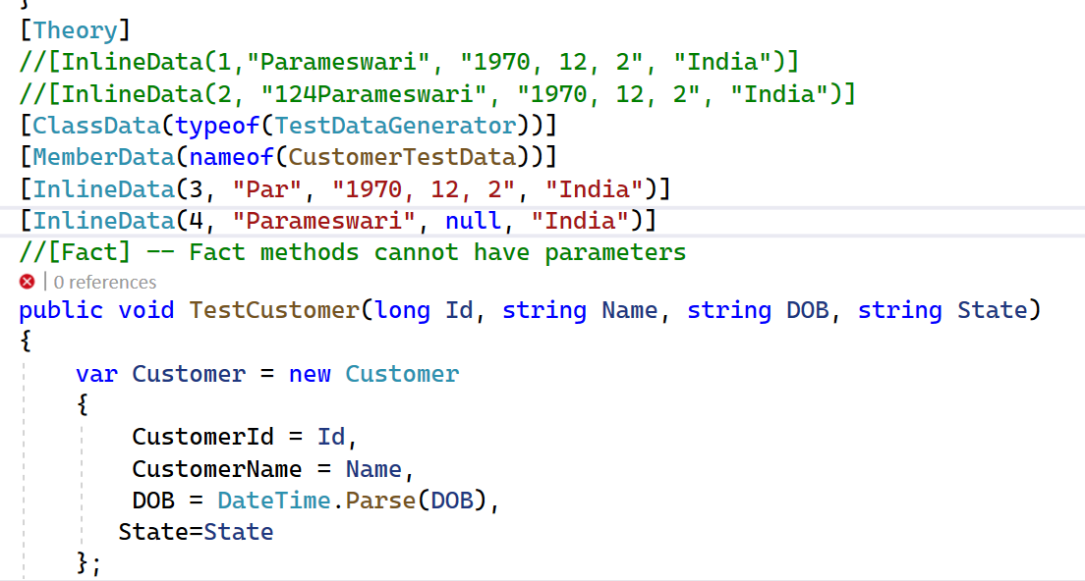
xUnit Parameterized Test

Slide 182
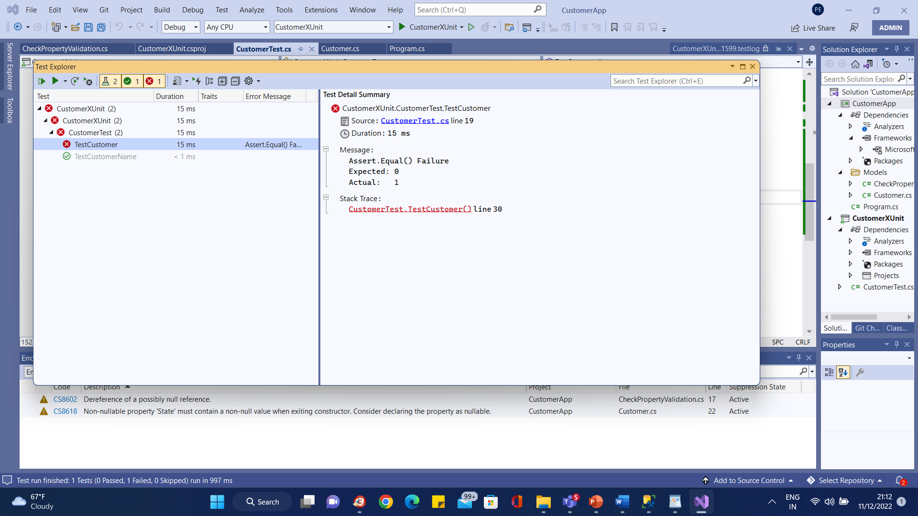
xUnit Test Explorer

Slide 183
xUnit Ignore Test
[Fact(Skip = "Thats how you ignore a test")]
public void ToIgnore()
{
Assert.False(true);
}

Slide 184
xUnit Set Up and Clean Replaced by Constructor and Dispose
When to use
when we want a clean test context for every test (sharing the setup and cleanup code, without sharing the object instance).
xUnit.net creates a new instance of the test class for every test that is run, so any code which is placed into the constructor of the test class will be run for every single test.
This makes the constructor a convenient place to put reusable context setup code where we want to share the code without sharing object instances (meaning, you get a clean copy of the context object(s) for every test that is run).

Slide 185
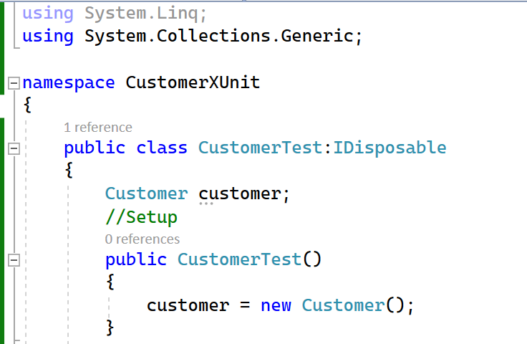
xUnit Set Up and Clean Replaced by Constructor and Dispose

Slide 186
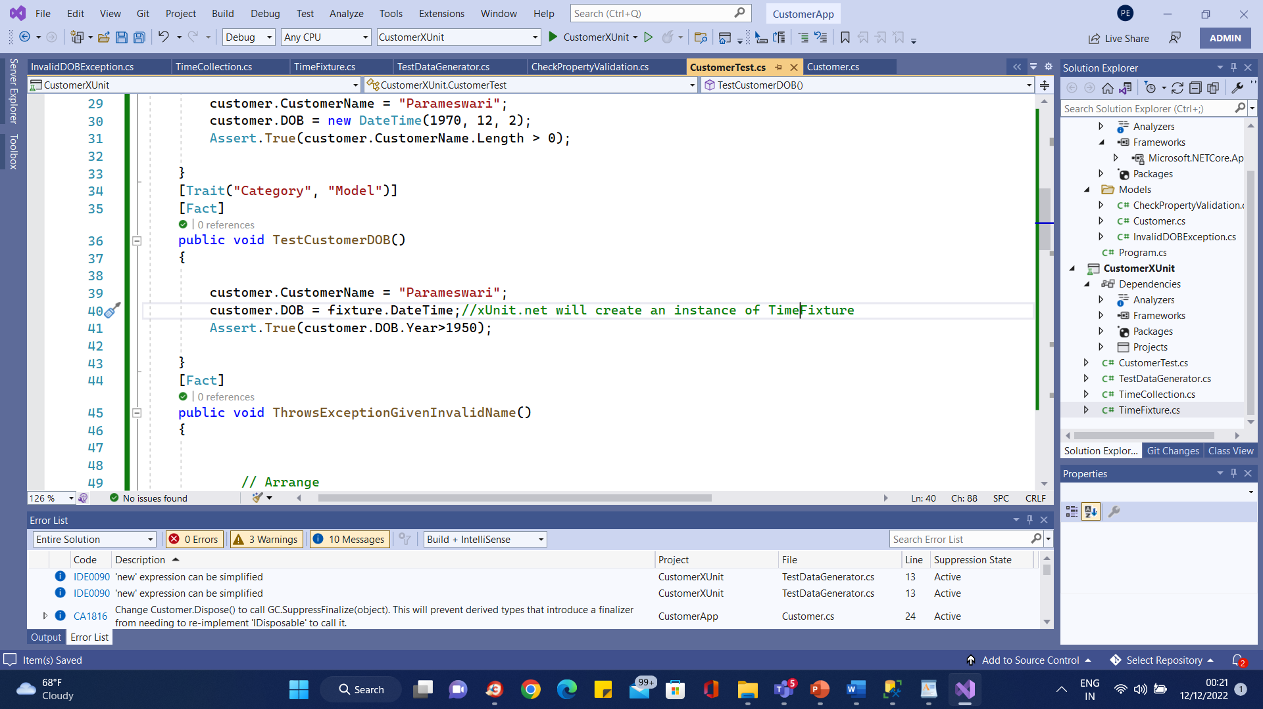
XUNIT Groups

Slide 187
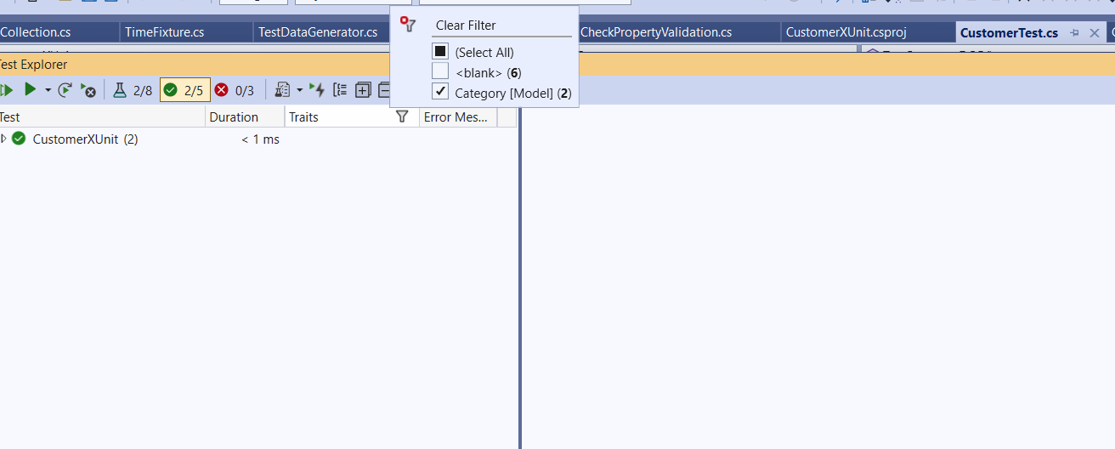
Xunit Groups

Slide 188
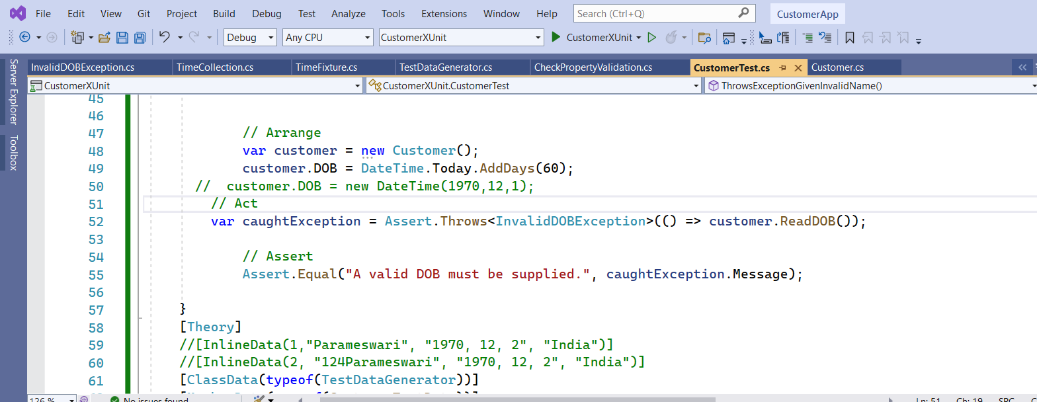
Assert Throws Exception

Slide 189
MSUnit Test
MSTest framework for Selenium automated testing is the default test framework that comes along with Visual Studio.
In the earlier days, it started as a command-line tool for executing tests.
It is also referred to as Visual Studio Unit Testing Framework.

Slide 190
MSUnit Test
The MSTest framework provides the necessary tools to verify & validate your source code.
The framework recognizes tests via the different attributes/annotations under which the test code is present.
Some of the popular attributes are [TestInitialize], [TestMethod], [TestCleanup], etc.
Since the MSTest framework comes pre-bundled with Visual Studio, developers who use the Visual Studio IDE for development & testing prefer the MSTest framework over other test frameworks like NUnit, xUnit.Net, etc.

Slide 191
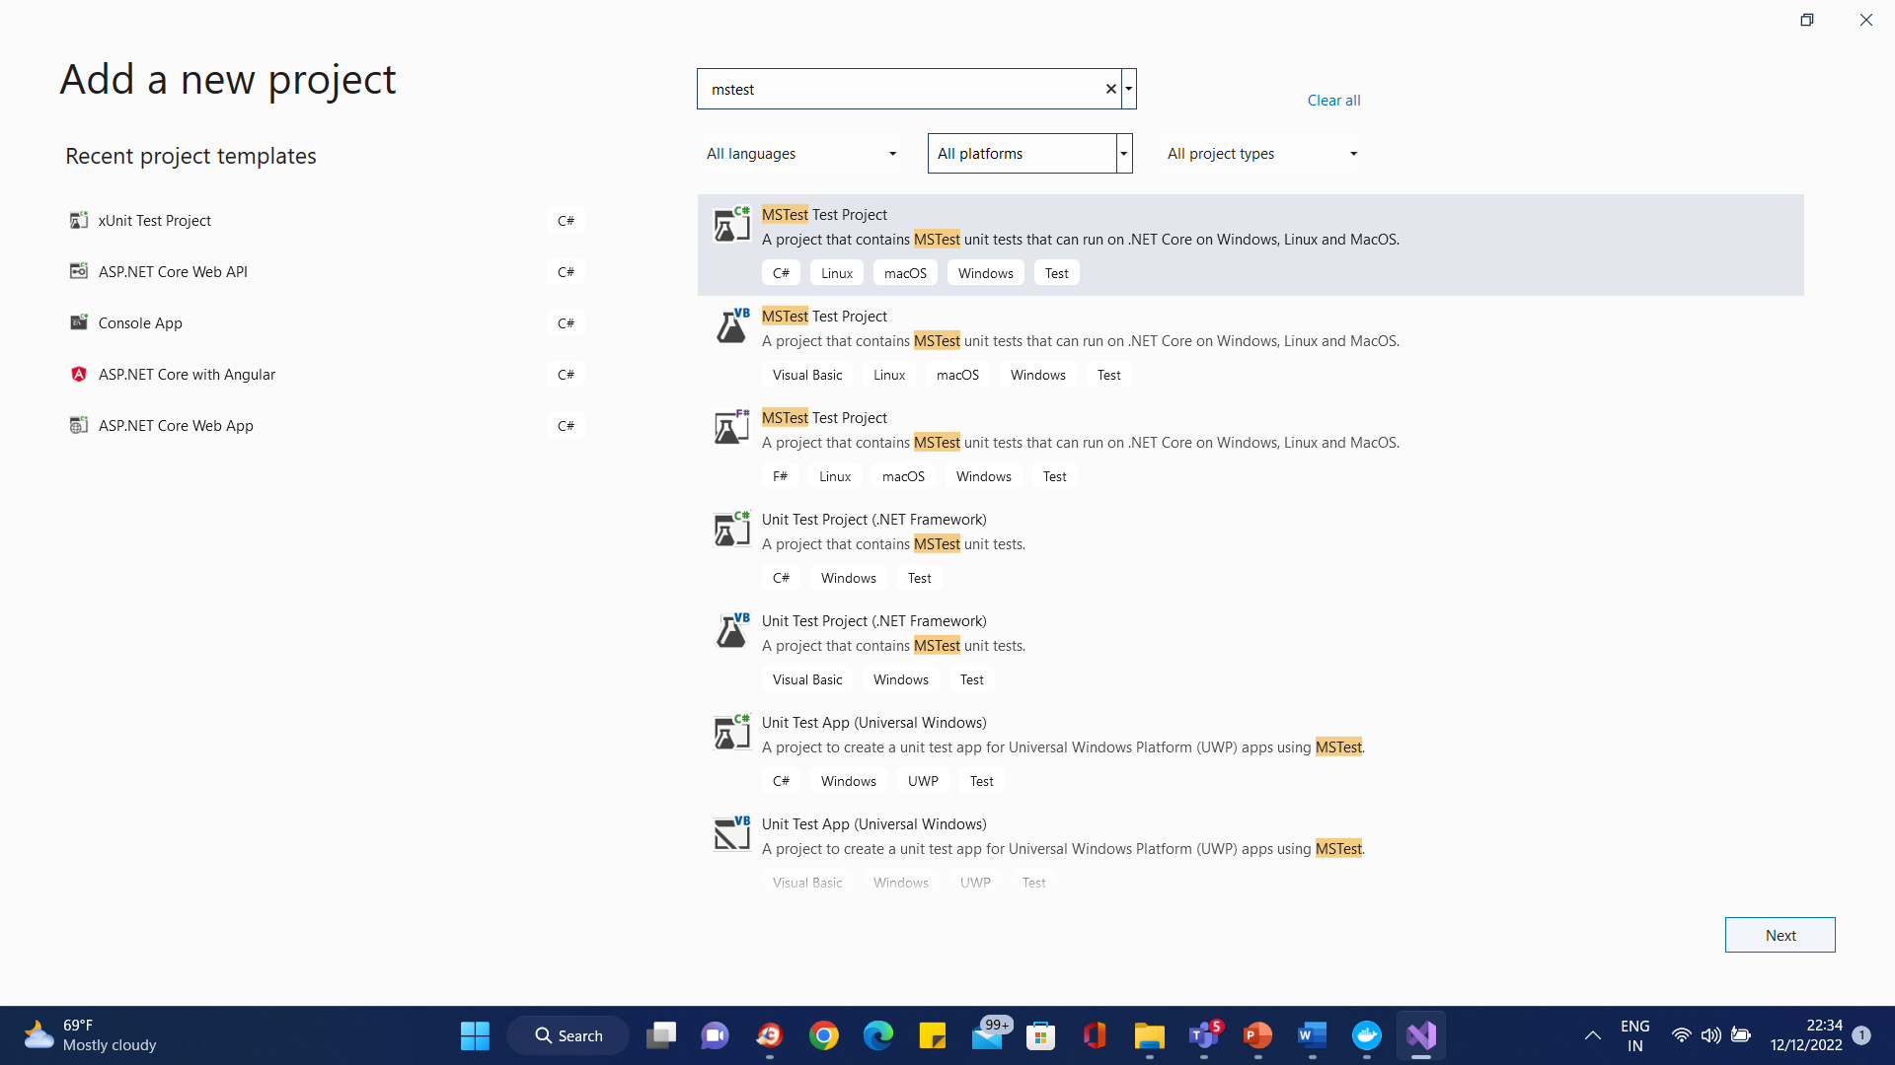
MSUnit Test

Slide 192
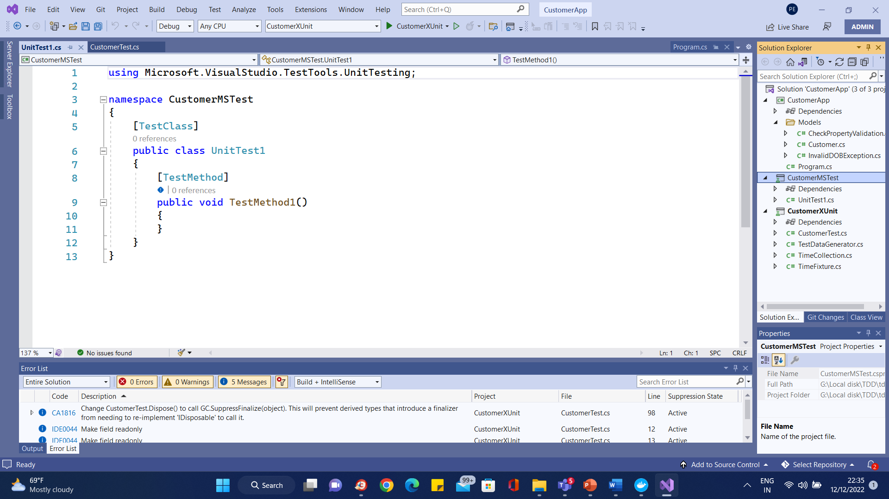
MSUnit Test

Slide 193
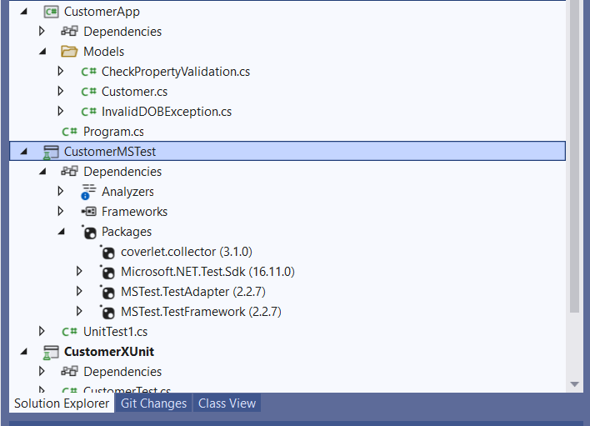
MSUnit Test packages

Slide 194
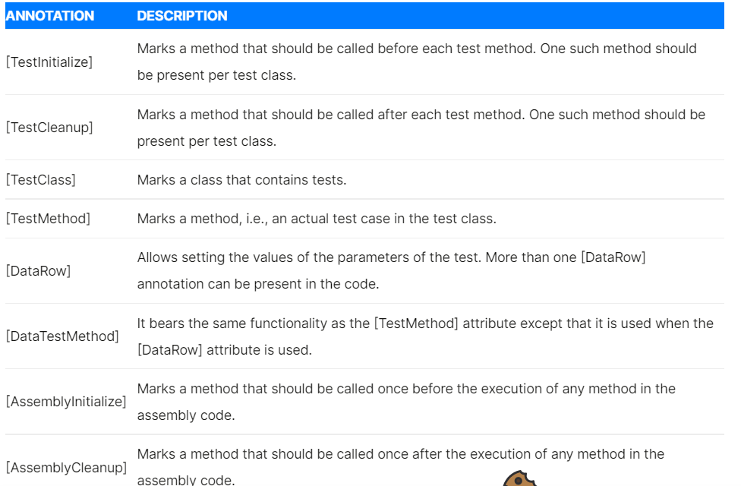
MSUnit Test packages

Slide 195
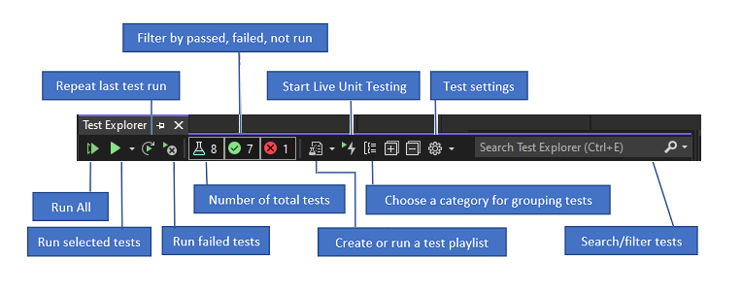
Running Tests

Slide 196
Boundary Conditions
Boundary testing is the process of testing between extreme ends or boundaries between partitions of the input values.
Extreme ends like Start- End, Lower- Upper, Maximum-Minimum, Just Inside-Just Outside values are called boundary values and the testing is called “boundary testing”.
The basic idea in normal boundary value testing is to select input variable values at their:
Minimum
Just above the minimum
A nominal value
Just below the maximum
Maximum

Slide 197
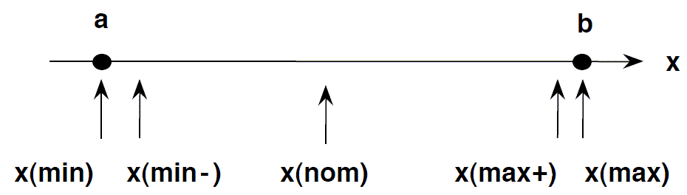
Boundary Conditions

Slide 198
Boundary Conditions
Example 1: Equivalence and Boundary Value
Let’s consider the behavior of Order Pizza Text Box Below
Pizza values 1 to 10 is considered valid. A success message is shown.
While value 11 to 99 are considered invalid for order and an error message will appear, “Only 10 Pizza can be ordered”

Slide 199

Boundary Conditions
Here is the test condition
Any Number greater than 10 entered in the Order Pizza field(let say 11) is considered invalid.
Any Number less than 1 that is 0 or below, then it is considered invalid.
Numbers 1 to 10 are considered valid
Any 3 Digit Number say -100 is invalid.

Slide 200

Boundary Conditions

Slide 201

Code Coverage Analysis(Default VS Test)

Slide 202
Questions

Slide 203
Module Summary

